Slide 1

Exploratory Data Analysis
G2M – Case study
26/06/2021

Slide 2

Agenda
Executive Summary
Problem Statement
EDA
EDA Summary

Slide 3
Problem Statement
XYZ is a private firm in US. Due to remarkable growth in the Cab Industry in last few years and multiple key players in the market, it is planning for an investment in Cab industry and as per their Go-to-Market(G2M) strategy they want to understand the market before taking final decision.
Objective: Provide actionable insights to help XYZ firm to identifying the right company for making investment

Slide 4
EDA

Slide 5
Source Data
Cab_Data.csv – this file includes details of transaction for 2 cab companies
Customer_ID.csv – this is a mapping table that contains a unique identifier which links the customer’s demographic details
Transaction_ID.csv – this is a mapping table that contains transaction to customer mapping and payment mode
City.csv – this file contains list of US cities, their population and number of cab users

Slide 6
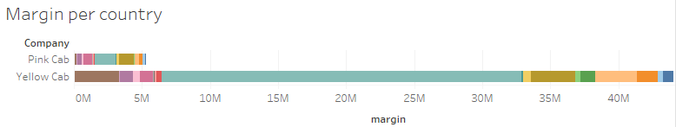
Profit analysis
Yellow Cab has the major profit
The most profitable country for both is New York City

Slide 7
EDA Summary

Slide 8
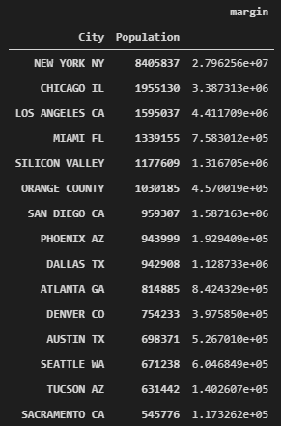
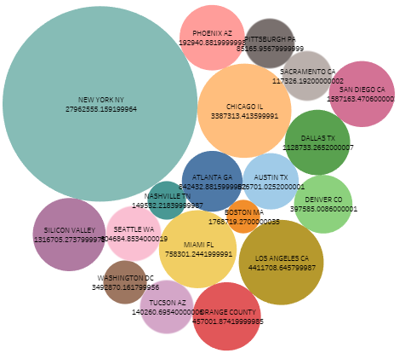
Does margin increase with a major population?

Slide 9
We use qualitative analysis because of the nature of the fields (categorical and numerical), particularly descriptive statistics and note that it's not neccesary that margin increases with population, but yes with number of users.

Slide 10
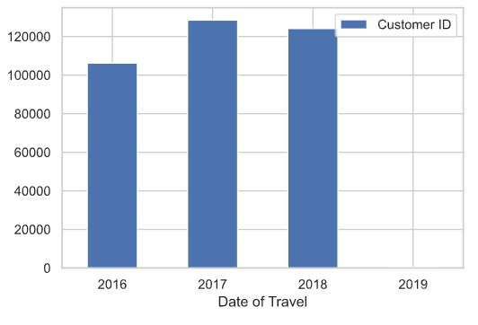
Are number of cab users increasing with time advance?
Using qualitative analysis, and a bar graph we can see that the number of user per year increase between 2017 and 2018 buy decrease in 2018, with regard to 2019 the data are insufficient.

Slide 11
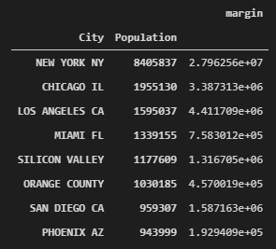
Is the most populated region the most profitable?
It correspond to New York and yes it's the most profitable region for both companies

Slide 12
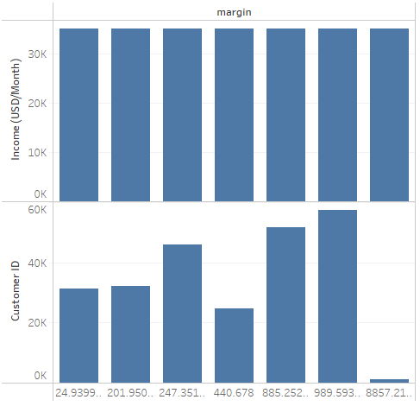
Is a user with major income related with more profit for the company?
The answer was no, the income of the user doesn't related with margin. (Analysis similar to recent hypothesis)

Slide 13
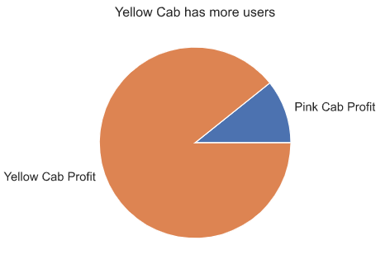
Is the company with more users the most profitable?
Yes, The company most profitable is Yellow Cab and has the major number of users

Slide 14
Thank You

